Slide 1
Foreign Words/Phrases
6th-8th Grades
http://www.merriam-webster.com/dictionary

Slide 2
Bon voyage (French): farewell; goodbye

Slide 3
Bonjour (French):
Hello
[bong-zhoor]

Slide 4
C’est la vie (French):
That’s life

Slide 5

E pluribus unum (Latin):
One out of many

Slide 6

Hasta la vista (Spanish): goodbye

Slide 7
Mi casa es su casa (Spanish):
My house is your house

Slide 8
Pro bono ( Latin):
Done or donated without charge; free
[pro boh’ noh]
For public good;

Slide 9

Carpe diem (Latin): seize the day!
[kar’pay dee’um]

Slide 10

Crème de la crème (French): the best of the best

Slide 11
Faux pas (French):
Social blunder
[foh pah’]

Slide 12
Esprit de corps (French): team spirit

Slide 13

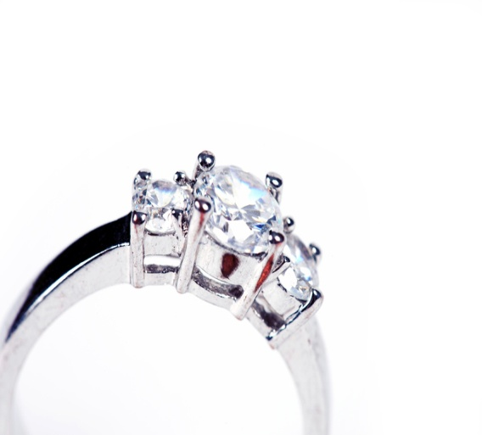
Bona fide (French):
Genuine, real, sincere
[boh’na fide]

Slide 14
Aloha (Hawaiian):
Hello/goodbye

Slide 15
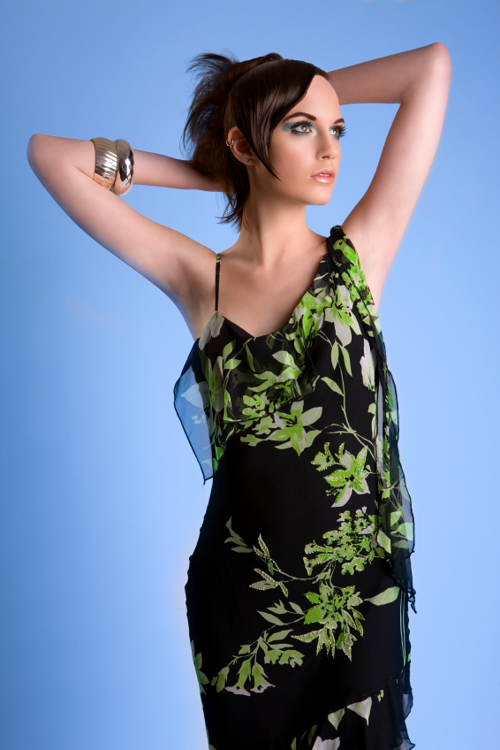
Au courant (French):
Current, up to date
[oh’ koo-rahn’]
“The shoes, the hair, the clothes- every
last detail of her dress, in fact- was
utterly au courant.”

Slide 16
Bon appétit (French):
Good appetite, enjoy your meal

Slide 17
Déjà vu (French): a feeling of having done or seen something before

Slide 18

Femme fatale (French) [fĕm' fə-tăl‘], : (disastrous woman)
1. Seductive woman who lures men into dangerous or compromising situations. 2. A woman who attracts men by an aura of charm & mystery.

Slide 19
Cum laude (Latin): with distinction; with praise

Slide 20
Summa cum laude (Latin): with highest distinction

Slide 21
Magna cum laude (Latin): with great distinction

Slide 22
Alma mater (Latin): a school college, or university which one has attended or from which one graduated; the song or hymn of a school, college, or university

Slide 23
RSVP (French): abbreviation for reponde s’il vous plait [seel voo play] (please reply); to respond to an invitation.

Slide 24

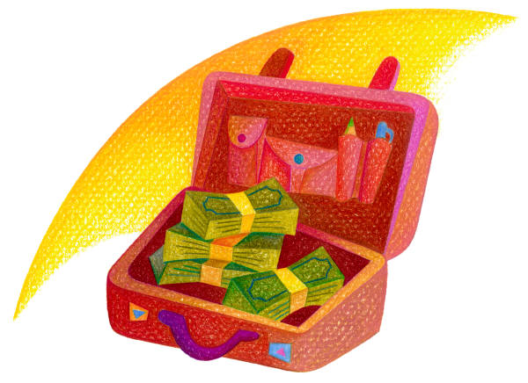
Dolce vita (Italian): literally, sweet life
: a life of indolence and self-indulgence -- called also la dolce vita

Slide 25

Au revoir (French): literally, till seeing again; goodbye
[oh rer-vwahr]

Slide 26
A la mode (French): topped with ice cream

Slide 27
Merci beaucoup (French): thank you very much
[mair-see ]

Slide 28
Feliz Navidad (Spanish):
Merry Christmas

Slide 29
Quid pro quo (Latin): an equal exchange

Slide 30
Savoir-faire (French): the ability to do the correct thing

Slide 31
Verbatim (Latin): in the exact words; word for word

Slide 32
En masse (French):
In one large group

Slide 33
Du jour (french): of the day
1. as prepared on the particular day; of the kind being served today: The soup du jour is split pea.
2. fashionable; current: environmentalism and other issues du jour.

Slide 34

A la carte (french): separate price for each item

Slide 35
Adios (spanish): goodbye

Slide 36
Amigos (spanish): friend

Slide 37
Eureka (Greek):
I’ve found it!

Slide 38
Buenos dias (spanish): good day
[bwe-naws thee-ahs]

Slide 39
Gracias (spanish): thank you

Slide 40
De nada (spanish): you’re welcome
YOUR

Slide 41
PADRE (SPANISH):
FATHER

Slide 42
SENOR (SPANISH):
MR./SIR

Slide 43
MADRE (SPANISH):
MOTHER

Slide 44
SENORA (SPANISH):
Mrs./ma’am

Slide 45
Al fresco (italian): outdoors

Slide 46
Vamonos (spanish): let’s go

Slide 47
Salud (spanish): used after a person sneezes or as a toast (“bless you”, “cheers”)
[sah-looth]

Slide 48
Chica (spanish): girl

Slide 49
Chico (spanish): boy

Slide 50
Etc. (abreviation for- et cetera)(latin): and so on; and other things
We can play with several things at recess
like: chalk, kick balls, jump ropes, etc. Etc.

Slide 51
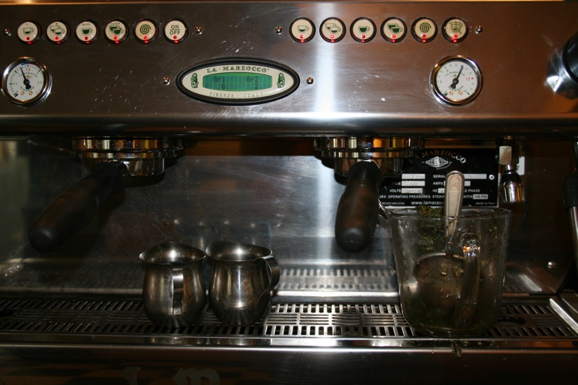
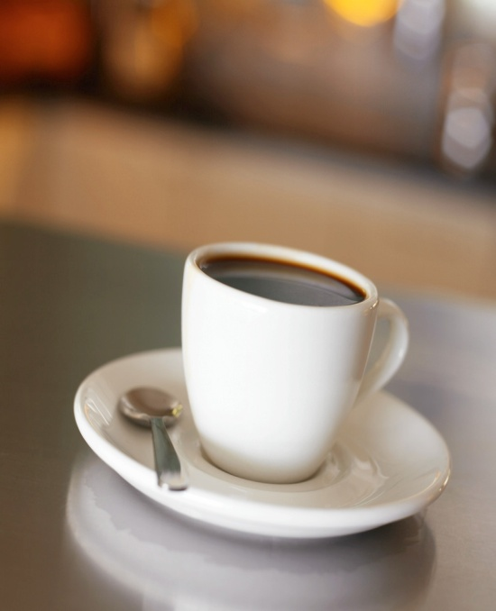
Espresso (italian): strong coffee

Slide 52
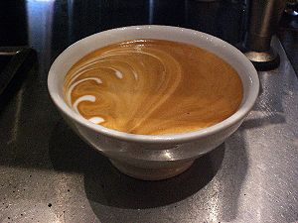
Caffe latte/café au lait (italian): coffee (espresso) with steamed milk

Slide 53
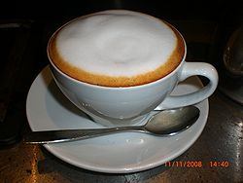
cappuccino (Italian): coffee drink prepared with espresso, hot milk, and steamed-milk foam.

Slide 54
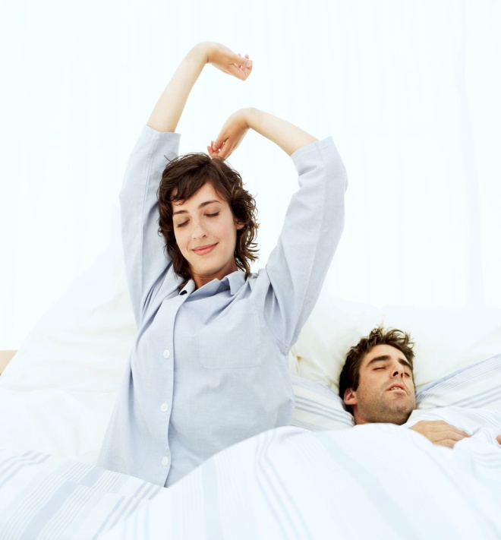
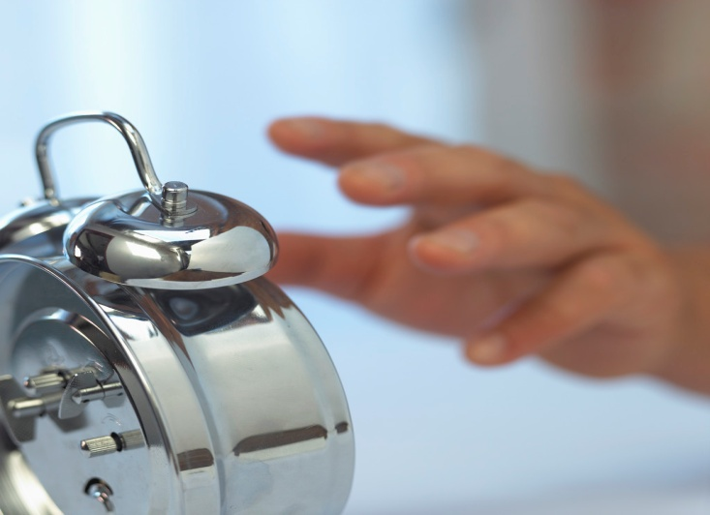
Hasta Manana (spanish):
[mä nyä′nä] so long; (I'll) see you tomorrow

Slide 55
Soup de jour

Slide 56
Per capita

Slide 57
Prima donna

Slide 58
Status quo

